Slide 1
Vocab. Unit 5 Lesson B
Define in your journals.
Page 520
Nonrenewable energy
Petroleum
Strip Mining
Subsurface mining Petrochemicals
Acid drainage
Energy Conservation
Quiz Next Class

Slide 2
Article Questions: Restate the questions and complete in your interactive journal.
What is the focus of the article?
When was it built?
How much did it cost?
Why is it being shut down?
(1 paragraph)

Slide 3
Non-Renewable Resources
Objectives
Essential Question
Analyze how responsible use of renewable and nonrenewable materials can affect potential environmental impact.
How can we conserve renewable and nonrenewable resources?

Slide 4
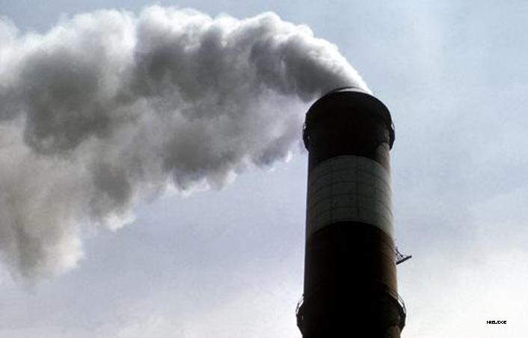
Lesson 17.3 Consequences of Fossil Fuel Use
The United States imports two thirds of its crude oil.

Slide 5

Pollution, Climate Change, and Public Health
Lesson 17.3 Consequences of Fossil Fuel Use
Burning fossil fuels releases carbon dioxide, which contributes to global climate change.
When coal and oil burn, sulfur dioxide and nitrogen oxides are released, which contribute to smog and acid deposition.
Oil spills, equipment ruptures, and oil in runoff pollute waterways, oceans, and coastal areas.
Coal-fired power plants release
mercury, which harms human
health. Crude oil contains trace
amounts of lead and arsenic.
Did You Know? Coal-burning power plants cause 40% of mercury emissions due to human activity in the United States.

Slide 6
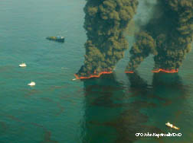
Gulf of Mexico Oil Well Explosions
Lesson 17.3 Consequences of Fossil Fuel Use
1979: Ixtoc I exploratory oil well
  50 m below surface
  Released 126 million gal oil; containment
  efforts took 9 months
  What didn’t work: cap, siphoning,
  controlled burn, “top kill”
  What did work: relief wells
2010: Deepwater Horizon oil well
  1500 m below surface
  Largest U.S. offshore oil breach as of 2010—21.2–33.5 million gal oil released during first 6 weeks, based on USGS rough estimates
  Hundreds of miles of coastal habitats threatened
  Methods tried: dome, cap, siphoning, controlled burns, “top kill,” “junk shot,” and relief wells
Controlled burns attempt to contain oil pumping into the Gulf, one month after the 2010 well blow-out.

Slide 7
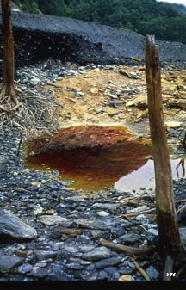
Damage Caused by Extracting Fuels
Lesson 17.3 Consequences of Fossil Fuel Use
Mining:
  Humans risk lives and respiratory health.
  Ecosystems are damaged by habitat destruction, extensive erosion, acid drainage, and heavy metal contamination downslope
  of mines.
Oil and gas extraction:
  Roads and structures built to support drilling break up habitats and harm ecosystems.
  The longterm consequences of accidents can be uncertain or unpredictable
Acid drainage from a coal mine

Slide 8
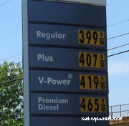
Dependence on Foreign Sources
Lesson 17.3 Consequences of Fossil Fuel Use
Fossil fuels are not evenly distributed over the globe, so some countries must import fuel sources.
Nations that import fuel may be
vulnerable to changes in fuel prices
set by suppliers.
Nations can import less fuel by
developing domestic oil sources
and renewable energy sources.

Slide 9

Energy Conservation
Lesson 17.3 Consequences of Fossil Fuel Use
Practice of reducing energy use to make fossil fuels last and to prevent environmental damage
  Transportation: Gas-efficient cars and higher gas prices could help conserve energy in the U.S.
  Personal choices: Individuals can save energy by turning off lights, taking public transit, and buying energy-efficient appliances.
Did You Know? Transportation accounts for 2/3 of U.S. oil consumption.

Slide 10
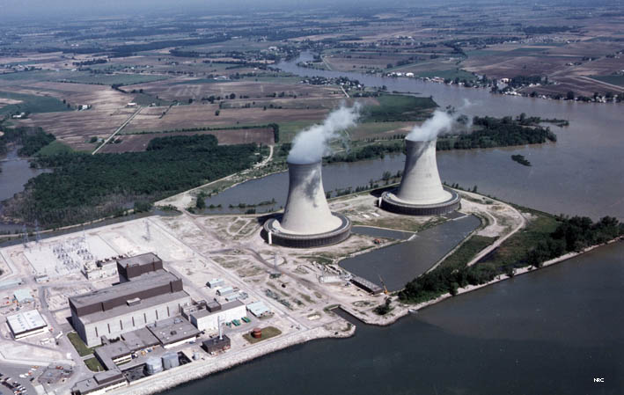
Lesson 17.4 Nuclear Power
Scientists estimate that nuclear power helps us avoid emitting 600 million metric tons of carbon each year worldwide.

Slide 11
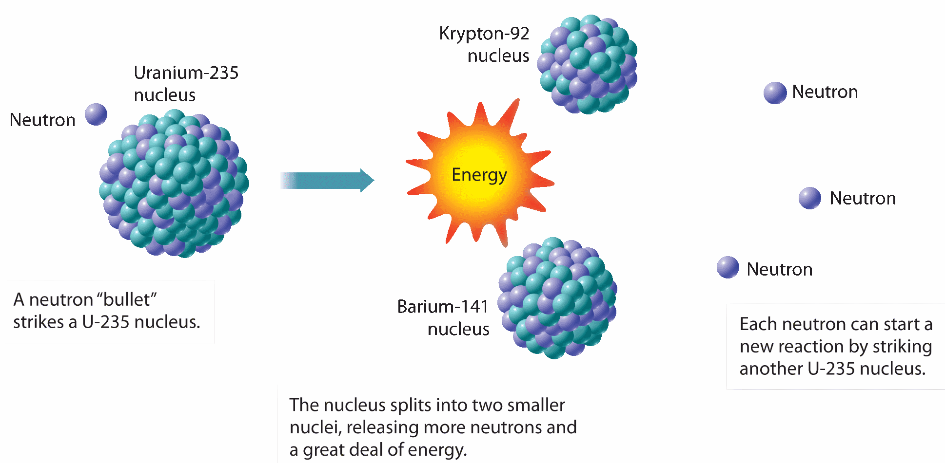
Nuclear Fission
Lesson 17.4 Nuclear Power
Splits an atomic nucleus into two smaller nuclei
Releases neutrons and large amounts of energy. If enough unstable nuclei are present, a nuclear chain reaction can occur.
Did You Know? About 20% of electricity produced in the United States comes from nuclear power.

Slide 12
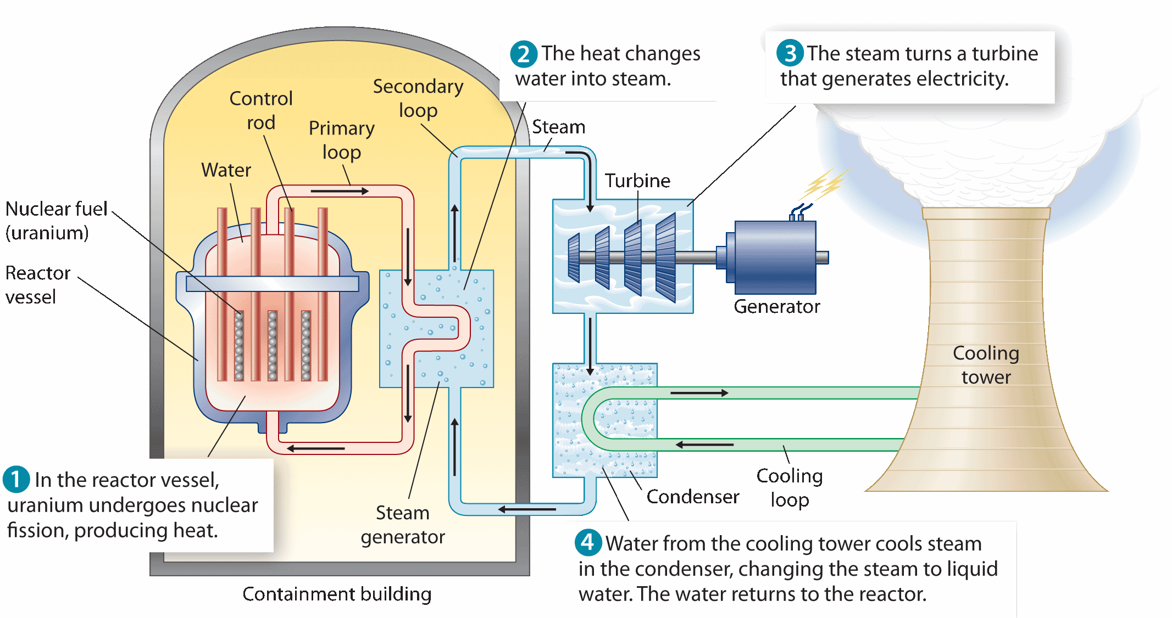
Generating Electricity Using Nuclear Energy
Lesson 17.4 Nuclear Power

Slide 13
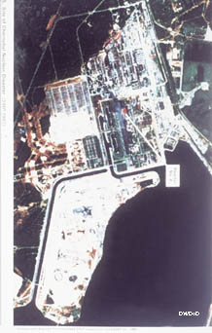
Benefits and Costs of
Nuclear Power
Lesson 17.4 Nuclear Power
Benefits | Costs
No air pollution | Expensive to build and maintain
Requires little uranium fuel and little mining | Catastrophic accidents are possible.
Under normal conditions, nuclear power plants are safer for workers than coal-burning power plants. | Nuclear waste must be stored for thousands of years.
Chernobyl

Slide 14
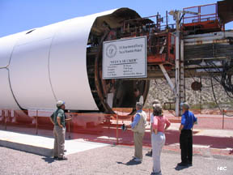
Nuclear Waste
Lesson 17.4 Nuclear Power
Waste is currently held at power plants as a stopgap, but a long-term storage location is needed.
Long-term storage sites must be distant from population centers, protected from sabotage, have a deep water table, and be geologically stable.
Yucca Mountain, Nevada, was
chosen by the U.S. government
in the 1980s, and a storage site
was constructed there. But, as of
2010, the Yucca Mountain project
is no longer under development.
Yucca Mountain storage site

Slide 15
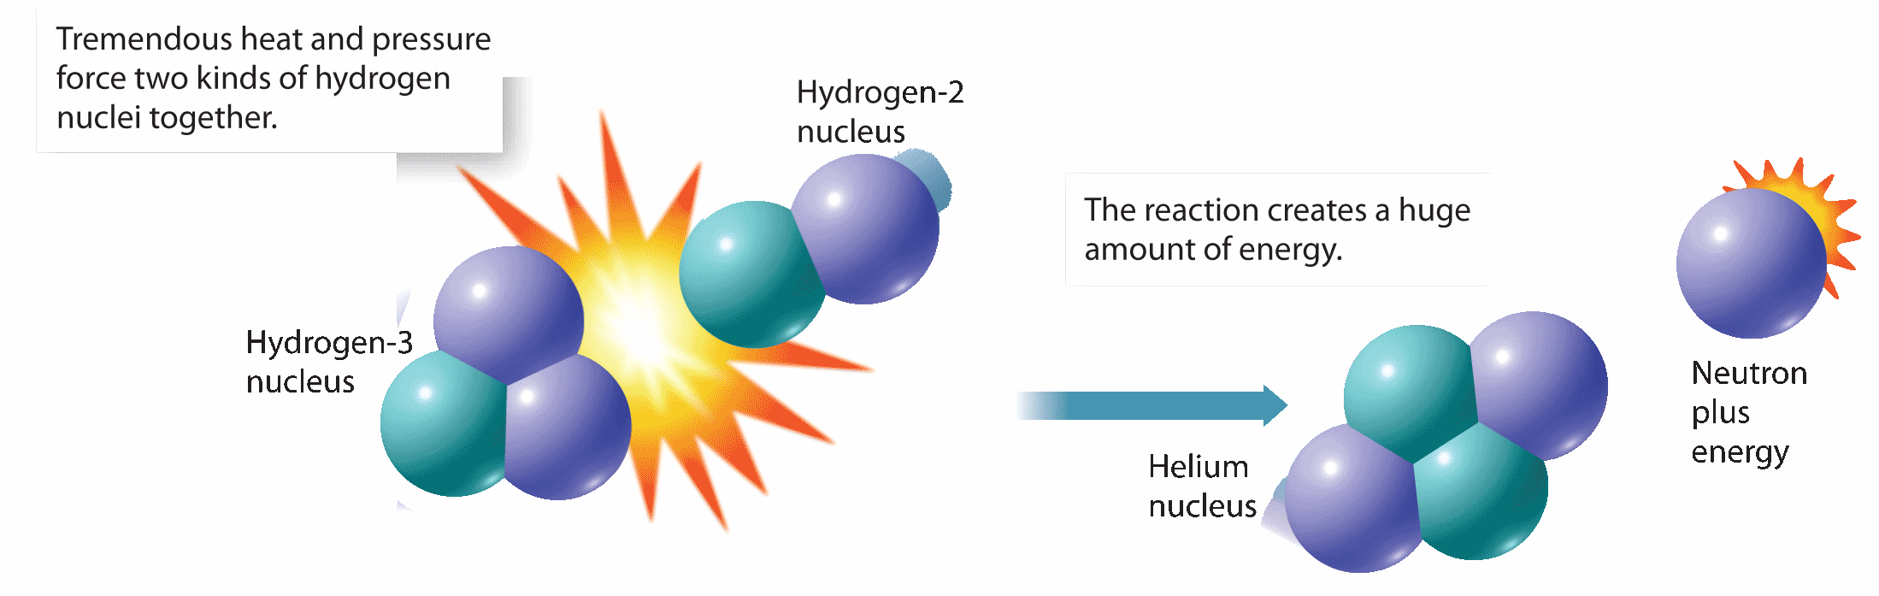
Nuclear Fusion
Lesson 17.4 Nuclear Power
Joining two atomic nuclei to form one nucleus
Releases much more energy than fission
Currently impractical because very high temperatures are needed, but scientists continue exploring fusion for our future energy needs

Slide 16
Class Work
4/7 (a-day) 4/11 (b-day)
page 528 (1-4)
Page 535 (1-3)
Page 541 (1-5)
REMEMBER I WILL NOT TAKE LATE WORK THIS FINAL QUARTER

Slide 17
INTRODUCTION
4/11 (a-day) 4/12 (b-day)
Because I will not accept any make up work (unless you have an excused absence) I have granted everyone with:
  10 Extra Credit Brownie Points
I will now hand out homework/classwork passes for the top brownie point earners from the third quarter.
If you still have one of these passes from the 2nd quarter, you need to use them before the end of the year.

Slide 18
8b - Types of Energy
4/12 (a-day) 4/13 (b-day)
Todays Objective:
Why is electricity considered a secondary source of energy?
How do carbohydrates provide energy to the body?
Evaluate the cost and benefits of nuclear power on society and the environment.
Essential Question:
Can we depend on nonrenewable energy resource for our energy needs?
Academic Standard:
SC.912.P.10.1 - Differentiate among the various forms of energy and recognize that they can be transformed from one form to others.
8A Assignment Completion
Article Summation

Slide 19
Complete 8a Assessments
4/12 (a-day) 4/13 (b-day)
Take the first 30 minutes of class in order to complete the assignment you started last class. I will hand back your assignments and you must begin working immediately. Upon expiration of the first 30 minutes all assignments will be collected and graded as is.
Assignment is due today unless you were absent last class. If you were absent you must turn in at the end of next class. YOU MUST WRITE THE QUESTION OR RESTATE IT IN YOUR ANSWER.
REMEMBER I WILL NOT TAKE LATE WORK THIS FINAL QUARTER

Slide 20
Bellringer
4/12 (a-day) 4/13 (b-day)
What is the difference between nuclear fission and nuclear fusion?
Hint: Are atoms splitting or combining? What releases more energy?
Complete on page 81/82 of journal.
Expect journals to be collected next week.

Slide 21
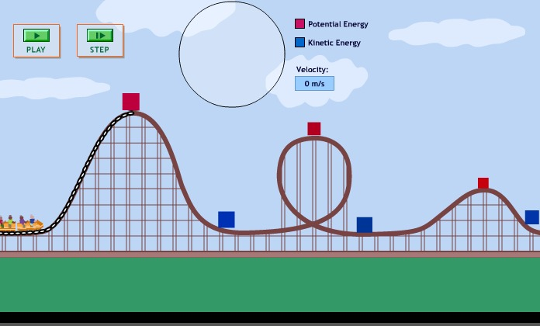
What is Energy
4/12 (a-day) 4/13 (b-day)
Energy is the ability to do work.
Kinetic Energy
Energy in motion
Potential Energy
Energy at rest
Gaining Potential
Gaining Kinetic

Slide 22

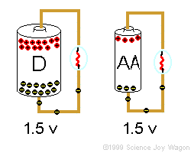
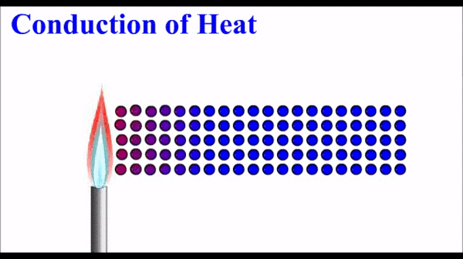

What is Energy
4/12 (a-day) 4/13 (b-day)
Mechanical Energy
Electrical Energy
Thermal Energy
Electromagnetic Energy

Slide 23
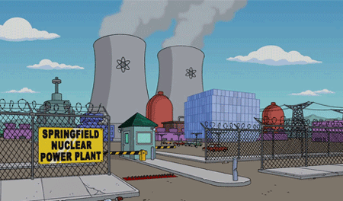
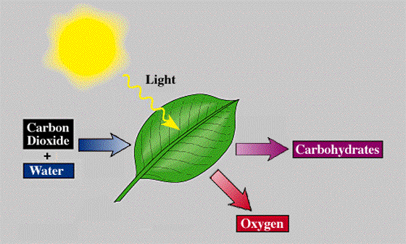
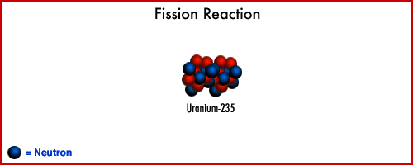
What is Energy
4/12 (a-day) 4/13 (b-day)
Chemical Energy
Nuclear Energy

Slide 24
Today’s assignment
4/12 (a-day) 4/13 (b-day)
Read the article on page 515
“Oil or Wilderness on Alaska’s North Slope?”
Writing Prompt: You are an U.S. congressmen in charge of a decision committee responsible for the future of Alaska’s north slope. Write a one page summation where you pick one side of the argument and defend your argument using your knowledge of the potential risks and benefits that your environmental and economical consultant (Mr. Gilmore) has been presenting all year.

Slide 25
8c – Renewable Energy Sources
4/14 (a-day) 4/15 (b-day)
Todays Objective:
Compare and contrast the different alternative energy sources.
Evaluate the costs and benefits of renewable energy sources.
Essential Question:
How can we generate energy without fossil fuels?
What are the potential uses and limitations of renewable energy sources?
Academic Standard:
SC.912.L.17.11 - Evaluate the costs and benefits of renewable and nonrenewable resources, such as water, energy, fossil fuels, wildlife, and forests.

Slide 26
Bellringer
4/14 (a-day) 4/15 (b-day)
Johnny was playing catch with his friends. The football traveling through the air is an example of energy in motion. This type of motion is called what?
Complete on page 82/83 of journal.
Expect journals to be collected next week.

Slide 27
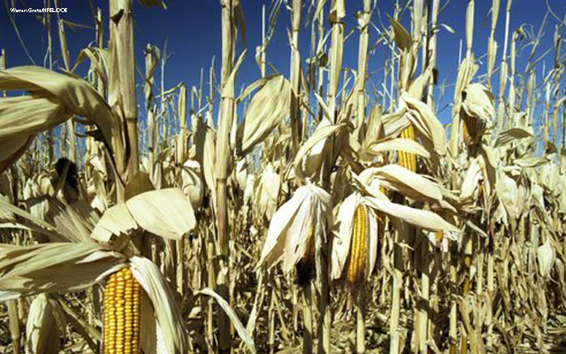
Lesson 18.1 Biomass and Geothermal Energy
Agricultural waste, methane gas from landfills, and heat from the Earth are just a few renewable energy sources that can help replace fossil fuels.

Slide 28
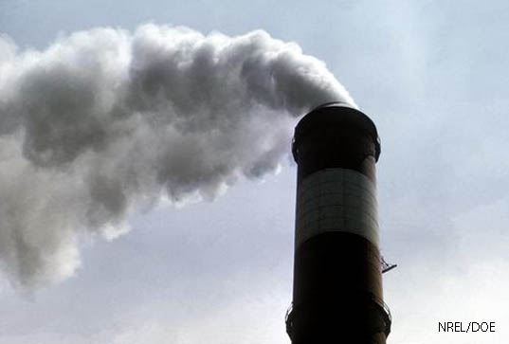
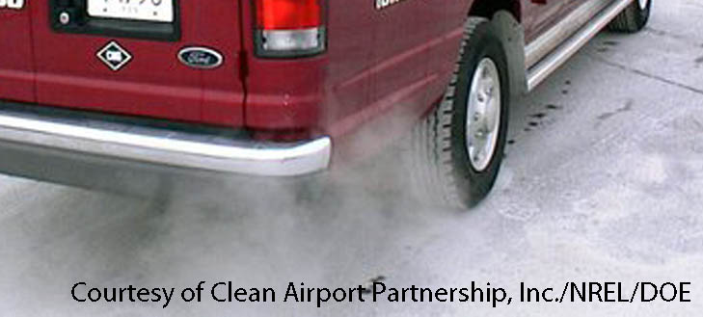
Why We Need Alternative
Energy Sources
Lesson 18.1 Biomass and Geothermal Energy
Economic reasons:
  Fossil fuels won’t last forever.
  Renewables provide new jobs.
  Our country will be less dependent on others for fuel.
Environmental reasons:
  Renewables will decrease air pollution and greenhouse gas emissions.
Did You Know? Fossil fuels currently supply 80% of the world’s energy, but renewable energy use is rapidly growing.

Slide 29
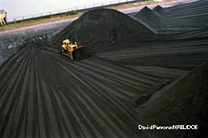
Biomass Energy
Lesson 18.1 Biomass and Geothermal Energy
Biomass is material—such as wood, manure, and grain—that makes up living organisms or comes from living organisms.
Biomass energy, called biopower, is produced by burning biomass.
Biomass energy can be used for heating, cooking, lighting, vehicle fuel, or electricity generation.
A front loader moves coal at a the Dunkirk steam station, in New York, which will soon be set up for cofiring biomass.

Slide 30

Biomass Energy Sources
Lesson 18.1 Biomass and Geothermal Energy
Solids: Wood, charcoal, manure, agricultural and timber waste, switchgrass
Liquids (biofuels): Ethanol and biodiesel
Gases: Methane “landfill gas” produced by breakdown of waste in landfills
Did You Know? Wood, charcoal, and manure supply 35% of the energy in developing nations, and over 90% of the energy in the world’s poorest nations.
Switchgrass

Slide 31
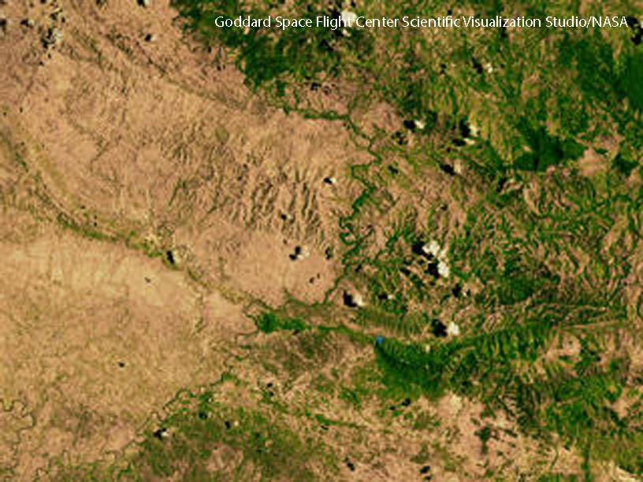
Benefits and Costs of
Biomass Energy
Lesson 18.1 Biomass and Geothermal Energy
Benefits:
  No net change in atmospheric carbon dioxide
  Can be produced by all nations
Costs:
  Takes away land from food crops or natural habitats
  Deforestation, soil erosion, and desertification can result if plant biomass is harvested too rapidly.
  Large energy input is needed.
  Burning biomass indoors can lead to indoor air pollution.
Deforestation can be seen at the border between the Dominican Republic (right) and Haiti (left).
Did You Know? It takes 1 unit of energy input to gain just 1.5 units of energy from ethanol.
Notes:
Image - http://www.flickr.com/photos/carolynconner/4264882098/ (Creative Commons licensed)
Geyser info source - National Park Service: http://www.nps.gov/yell/planyourvisit/noldfaith.htm

Slide 32
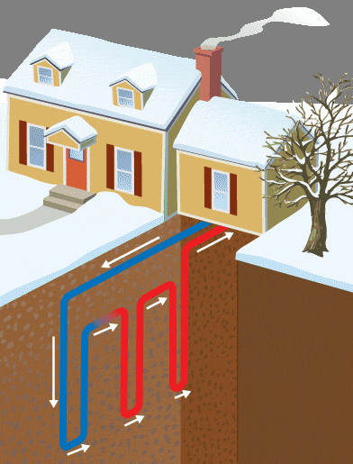
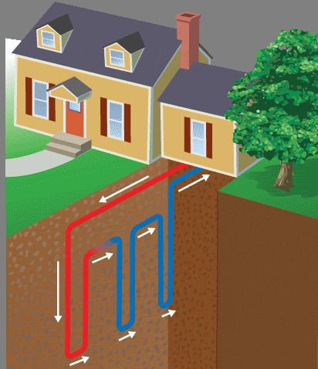
Geothermal Energy
Lesson 18.1 Biomass and Geothermal Energy
Underground heat generated by high pressures and breakdown of radioactive elements
Usually accessed by drilling deep below ground; steam turns turbines, generating electricity.
Can be used directly by piping hot water from its source into homes and businesses
Ground source heat pumps use naturally temperate soil, a few feet underground, to heat homes in winter and to cool them in summer.
A ground source heat pump in winter and summer
Notes:
Image - http://www.flickr.com/photos/carolynconner/4264882098/ (Creative Commons licensed)
Geyser info source - National Park Service: http://www.nps.gov/yell/planyourvisit/noldfaith.htm

Slide 33
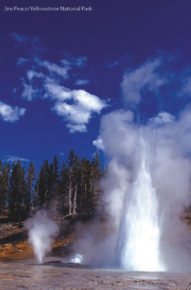
Benefits and Costs of
Geothermal Energy
Lesson 18.1 Biomass and Geothermal Energy
Benefits:
  Causes much less air pollution than fossil fuels
  Low greenhouse gas emissions
Costs:
  Not sustainable if hot groundwater is used faster than it is naturally replenished
  Hot groundwater can contain pollutants that damage machines or add to pollution.
  Some geothermal energy projects can trigger earthquakes.
  Geothermal power plants can only be built in places with easy access to geothermal energy.
Notes:
Image - http://www.flickr.com/photos/carolynconner/4264882098/ (Creative Commons licensed)
Geyser info source - National Park Service: http://www.nps.gov/yell/planyourvisit/noldfaith.htm

Slide 34
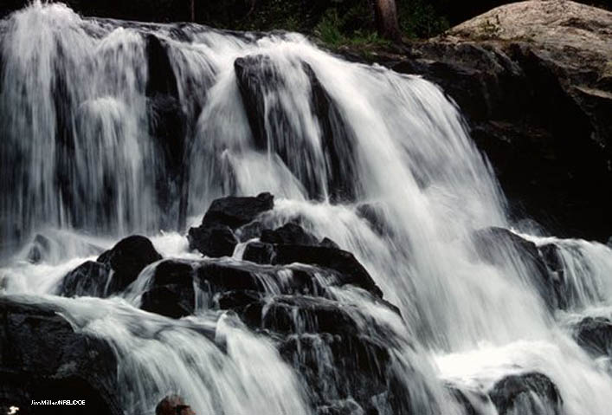
Lesson 18.2 Hydropower and Ocean Power
Currently, 19% of the world’s electricity is made using hydropower.

Slide 35
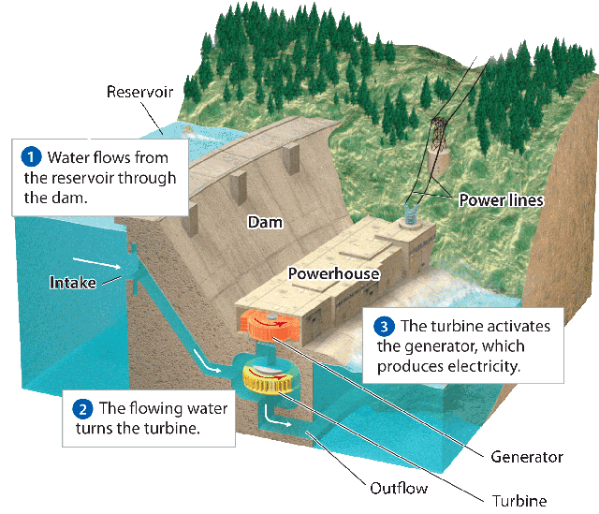
Generating Electricity
With Hydropower
Lesson 18.2 Hydropower and Ocean Power
Hydropower is generated by turbines turned by moving water.
Two basic approaches:
  Water flows through a dam
  and pushes turbines.
  Naturally flowing water is
  diverted through turbines.
Naturally flowing water
can lead to a variable supply of electricity. Dams provide constant electricity but can disturb natural habitats.

Slide 36
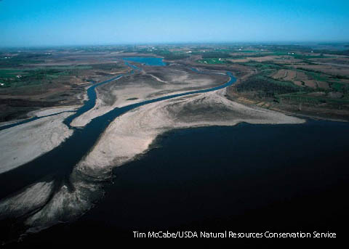
Benefits and Costs of Hydropower
Lesson 18.2 Hydropower and Ocean Power
Benefits:
  Completely renewable
  No air pollution or greenhouse gas emissions
  Yields relatively cheap electricity
Costs:
  Dams alter ecosystems and affect organisms (especially fish).
  Dams trap soil-enriching silt, preventing it from reaching downstream.
  Building dams and reservoirs can displace people.

Slide 37
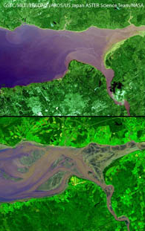
Tidal Energy
Lesson 18.2 Hydropower and Ocean Power
Electricity generated by the flow of ocean water as tides go in and out
Tidal waters push turbines in
a dam.
The best places to harness tidal energy have big differences in the heights of high and low tides.
Generates little to no pollution, but shore ecosystems can be negatively affected and very few locations are currently suitable
High and low tide in the
Bay of Fundy, Nova Scotia

Slide 38
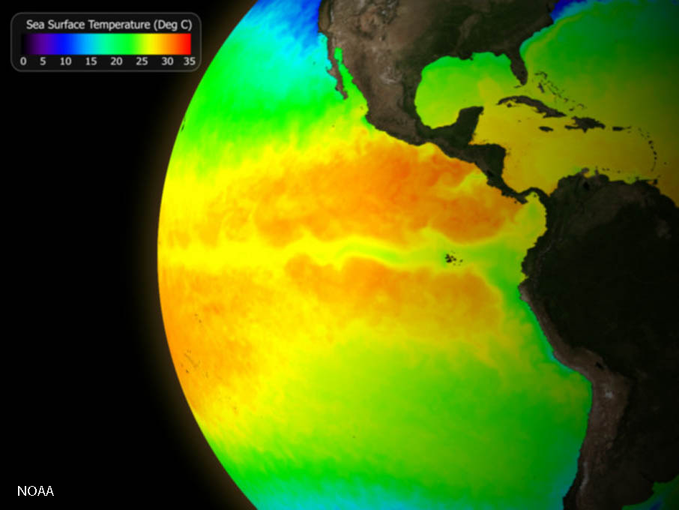
Thermal Energy From the Ocean
Lesson 18.2 Hydropower and Ocean Power
The ocean absorbs solar energy and stores it as heat.
Ocean thermal energy conversion (OTEC) converts heat energy in the ocean to electricity.
Warm ocean water is used to boil liquids with very low boiling points, generating vapors that can spin turbines.
OTEC technology is currently under development; no power plants use this method today.
Did You Know? The heat content absorbed every day by tropical oceans is equivalent to the heat content of 250 million barrels of oil.

Slide 39
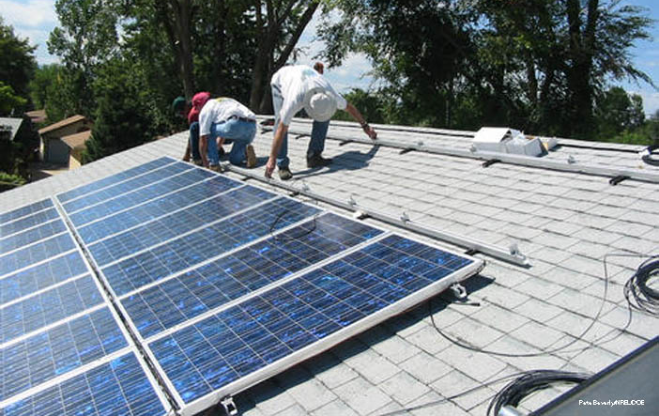
Lesson 18.3 Solar and Wind Energy
In one day, the Earth receives enough energy from the sun to meet human energy needs for 25 years—if it could all be harnessed.

Slide 40
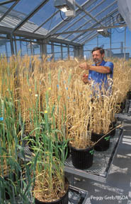
Harnessing Solar Energy for Heat
Lesson 18.3 Solar and Wind Energy
Passive solar heating: Designing a building to efficiently capture, store, and distribute the sun’s energy; can be used to heat homes and businesses
Active solar heating: Uses technology, such as solar panels, to capture, store, and distribute the sun’s energy
Did You Know? Greenhouses, thick window drapes, and south-facing windows are all passive solar energy “devices.”

Slide 41
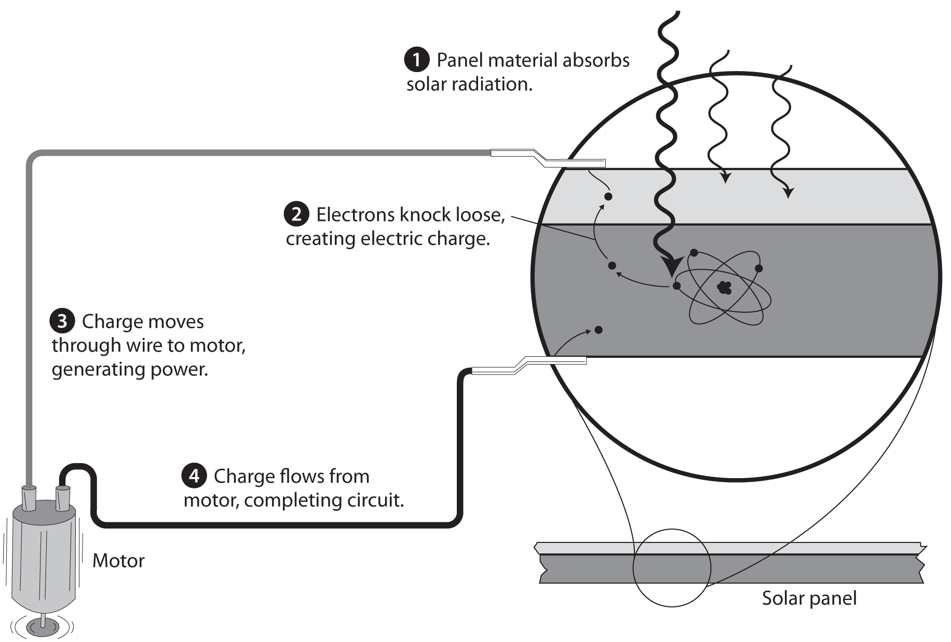
Harnessing Solar Energy to
Make Electricity
Lesson 18.3 Solar and Wind Energy
Photovoltaic cells (solar panels): Convert solar energy directly into electricity
Concentrating solar power: Uses mirrors to focus the sun’s rays on a vessel containing fluid; creates steam to push turbines and generate electricity.
Solar Panel

Slide 42
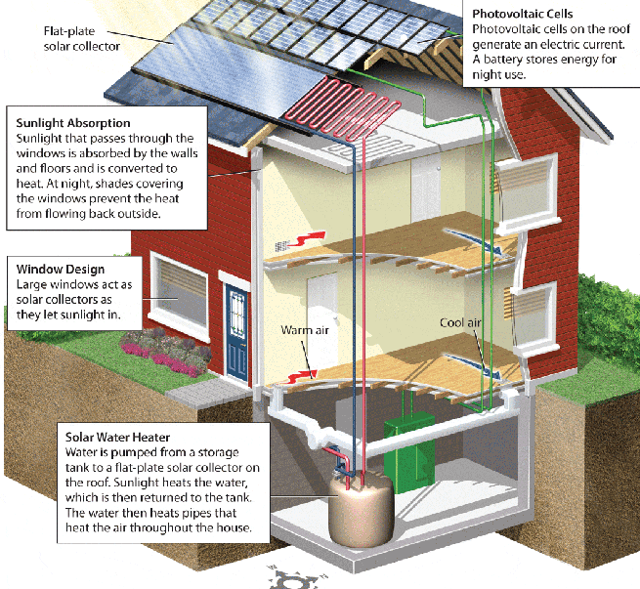
Benefits and Costs of Solar Power
Lesson 18.3 Solar and Wind Energy
Benefits:
  Inexhaustible
  Clean—no air or water pollution produced during operation
  Low maintenance devices
  New jobs to make solar devices
Costs:
  Some pollution during manufacture
  Many regions aren’t sunny enough.
  Devices are expensive.

Slide 43
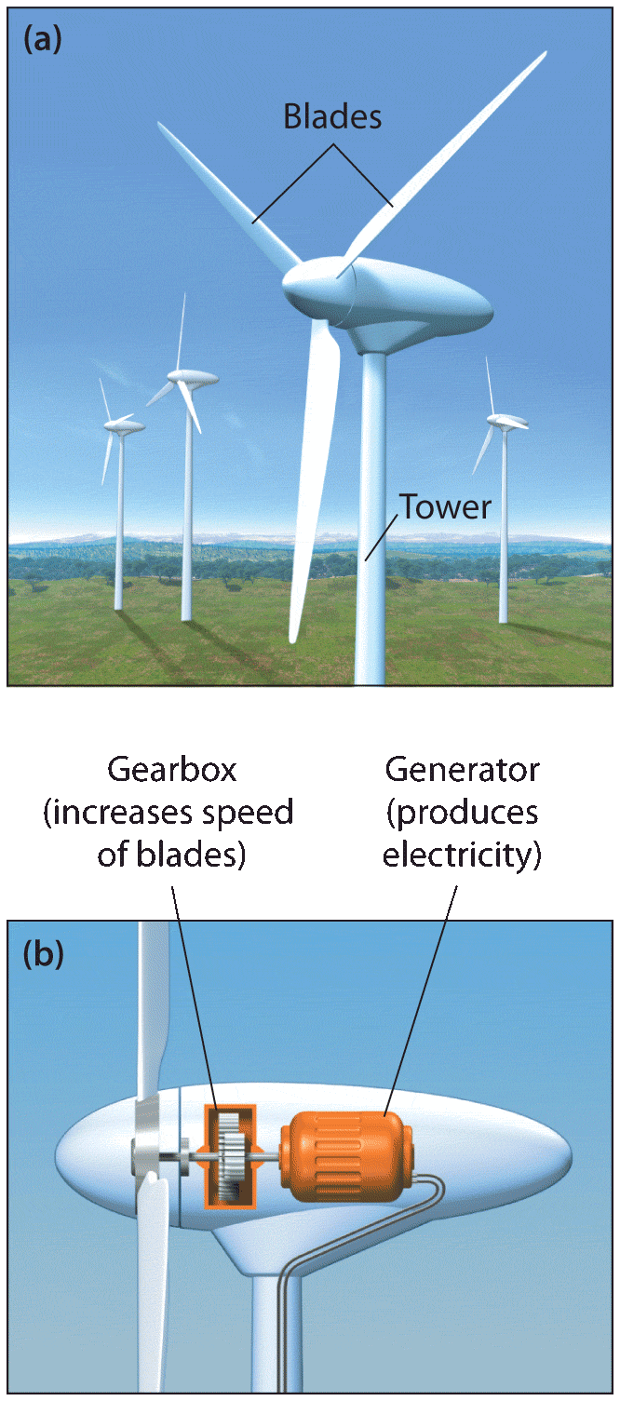
Using Wind to
Make Electricity
Lesson 18.3 Solar and Wind Energy
Wind turbines (windmills) convert wind’s kinetic energy to electrical energy.
Wind turbines can be placed on land or offshore.
Turbines can be solitary or built in groups called wind farms.
Did You Know? Average wind speeds are 20% faster offshore than on land.

Slide 44
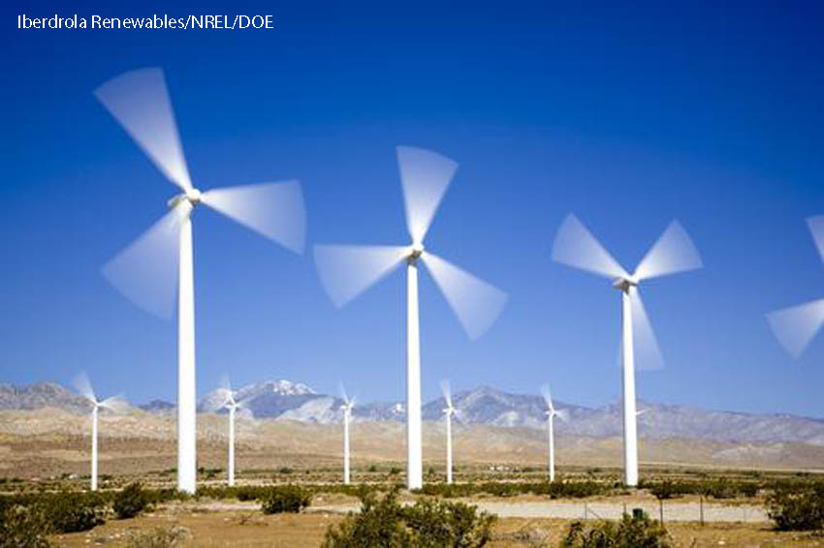
Benefits and Costs of Wind Power
Lesson 18.3 Solar and Wind Energy
Benefits:
  No pollution or greenhouse gases produced during operation
  Under good wind conditions, produces far more energy than it uses
  Relatively cheap to operate
Costs:
  High startup costs
  Winds can be unpredictable.
  Fastest winds are often not near population centers.
  Communities complain about the looks and noise of wind farms.
  Can be harmful to birds and bats

Slide 45
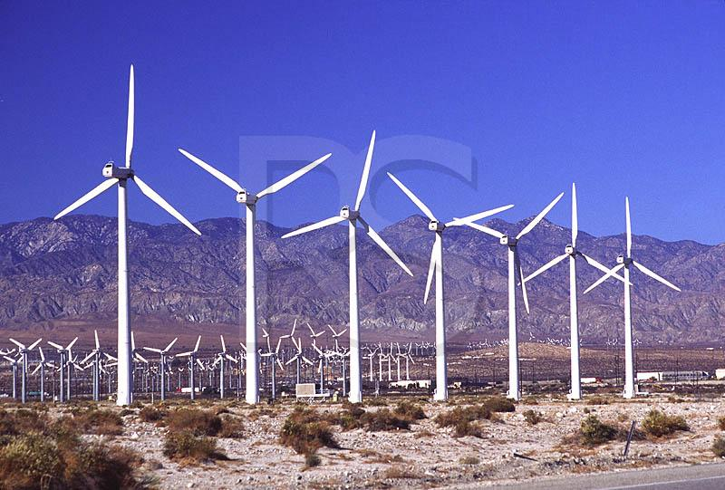
Dirty Jobs Video

Slide 46
Vocabulary Terms Homework
1. Petrochemicals
2. Strip mining
3. Subsurface mining
4. Nuclear Fusion
5. Nuclear Fission
6. Biomass
7. Geothermal energy
8. Hydropower
9. Tidal Energy
10. Concentrating Solar Power
11. Wind Turbine
12. Fuel Cells
13. Biofuels
Due at beginning of next class.

Slide 47
Today’s Agenda
4/18 (a-day) 4/19 (b-day)
Bellringer review question (5 min)
Unit 8 Test Review (45 min)
Make up work for absences
End of day assignment

Slide 48
Bellringer Question
4/18 (a-day) 4/19 (b-day)
By developing alternative energy sources such as biomass, wind and solar power we will be less dependent on foreign oil. Name one advantage to each of the alternative energy sources we covered.
Biomass
Geothermal
Hydropower
Solar Power
Wind Power

Slide 49
Jeopardy Review
4/18 (a-day) 4/19 (b-day)
Split into groups of no more than five people and give your team a name (max of five groups total)
The group to start of the board will be chosen by picking a number closest to the one I am thinking of
The winning group will receive ten extra credit points
The group in second place will receive 5 EC points
DO NOT BLURT OUT ANSWERS
Discuss each question with your group and when you have the answer raise your hand.
The first group to raise their hand will have the opportunity to answer the question
If an incorrect answer is given, that group is not allowed to try a second time and all other groups will raise their hands.
The group with the most points at the end of the game wins.

Slide 50
Absentees Make Up work
4/18 (a-day) 4/19 (b-day)
The assignments for this quarter as are follows
Rock Description Lab
p 528 (1-4), p 535 (1-3), p 541 (1-5)
Read p 515 and choose a side to defend
Unit 8 Vocabulary (13 terms)
If absent during one of these days you can make it up. If you were here for the assignment you cannot make it up. All make-up work will be referenced with my attendance for accuracy. Due before the test next class.

